Slide 1
Import–Export Trade
Analytics System
Final Year Project — BCA
Shamim Fatima Rayeesahmed Khatib
Bachelor of Computer Applications (BCA) | Nehru BBA & BCA College, Gantikeri, Hubli | 2025–26
Guide Name: Sana Lakkundi

Slide 2
Introduction
What is Import–Export Trade Analytics & Why This Project?
What is Trade Analytics?
Purpose of this Project
200+ countries, billions of daily trade records
Identify top importing & exporting countries
Uncover product trends & seasonal patterns
Converts raw data into business intelligence
Build Power BI dashboards
Uses India's TradeStat government platform
Eliminate manual errors via automation
Automates collection, processing & visualization
Support data-driven strategic decisions

Slide 3
Problem Statement
Why Manual Trade Analysis Fails at Scale
Manual trade analysis is inefficient & error-prone at scale
Poor Data Quality
No EDA Support
Scalability Issues
Inconsistent & incomplete records
Cannot identify patterns or trends
Cannot scale with growing data
Weak Visualization
Outdated Data
Poor charts, low clarity
Stale data = delayed decisions

Slide 4
Project Objectives
5 Core Goals of the Import–Export Trade Analytics System
01
Data Collection
Collect data from TradeStat
02
Data Analytics
Process & interpret large datasets
03
Products Insights
Find top trading products
04
Visualization
Visualize via Power BI dashboards
05
Decision Support
Enable data-driven decisions

Slide 5
Tools & Technologies Used
Tech Stack Powering the Trade Analytics System
Excel
MySQL
Python 3.10
Data cleaning & formatting
Structured storage
Processing & DB connector
Cleans & formats raw data
Stores all trade records; fast SQL queries
Links MySQL to Power BI via connector
Power BI
MS Fabric
VS Code
Interactive dashboards
Cloud publishing
Python IDE
KPI cards, bar charts, trend lines
Publishes dashboards to cloud
Write, test & debug Python scripts

Slide 6
System Architecture
End-to-End Data Pipeline Flow
01
03
05
Excel
Raw Data
Python
Connector
MS Fabric
Cloud
02
04
06
MySQL
Database
Power BI
Dashboard
User UI
Output
End-to-end automated pipeline: Excel → MySQL → Python → Power BI → Cloud → User

Slide 7
How the System Works
7-Step Data Processing Workflow
1
2
3
4
Data Collection
Data Cleaning
MySQL Storage
Python Connection
Download from TradeStat (CSV/Excel)
Remove duplicates, fix missing values
Load into MySQL database
Connect Power BI to MySQL via Python
5
6
7
Power BI Dashboard
Publish via MS Fabric
Final UI Output
Generate KPIs, charts & analytics
Publish to Microsoft Fabric cloud
Access with filters & drill-downs

Slide 8
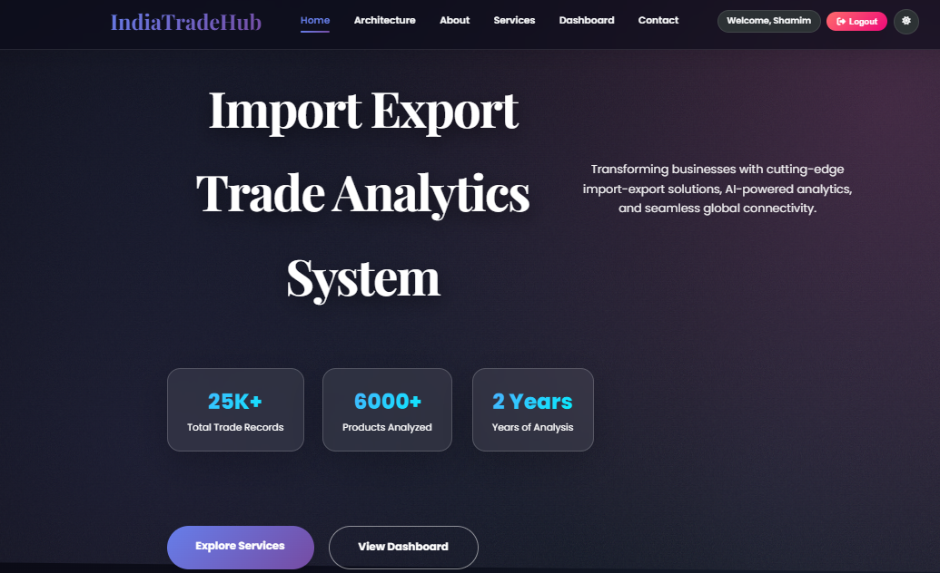
Homepage & Login Interface
IndiaTradeHub — System Frontend
Homepage Features
25K+
6000+
2 Years
Total Trade Records
Products Analyzed
Years of Analysis
Quick access to dashboards
Navigation: Home, Architecture, Dashboard
Secure login & registration
Optimized for daily use
Login → Dashboard for full analytics

Slide 9
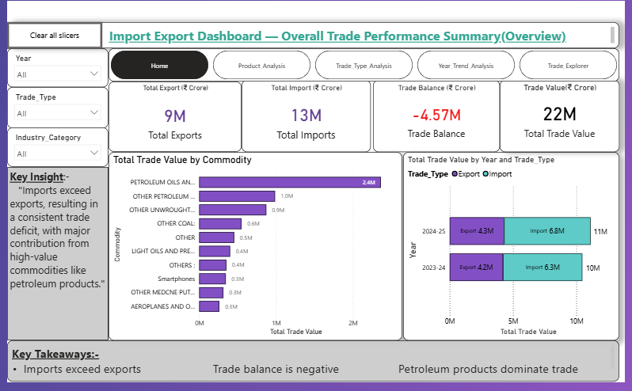
Dashboard & Analytics Results
Power BI Dashboard — Trade Performance
Key KPIs
9M ₹
13M ₹
Total Exports
Total Imports
-4.57M
22M ₹
Trade Balance
Total Trade
Key Insights
Imports exceed exports → trade deficit
Petroleum Oils: highest trade value
YoY growth: 10M → 11M (2023–25)

Slide 10
Advantages & Future Scope
What the System Delivers Today & Where It Can Go Tomorrow
Advantages
Future Enhancements
Automated Pipeline
01
Real-time Integration
Removes all manual data tasks
Live data from TradeStat
Faster & More Accurate
Faster & more accurate results
02
ML Predictions
ML-based trade forecasting
Scalable Processing
Scales with large data volumes
03
Web-Based Dashboard
Rich Visualization
Browser-accessible web dashboard
Charts reveal hidden trends
04
Multiple Data Sources
Reduced Manual Effort
Integrate WTO & global platforms
More time for strategy, less for data prep

Slide 11
Conclusion
Transforms raw trade data into actionable insights using Power BI & automation.
Automated end-to-end pipeline
Power BI dashboards with KPIs & trends
Scalable MySQL backend
Ready for real-time & ML upgrades
Thank You!

